Slide 1
Aplicações de feixes de íons de baixa energia (~MeV) em nanotecnologia e materiais quânticos
Proposta para contratação de novo docente

Slide 2
Summary
Relevance
Viability
Rationale
Human resources

Slide 3
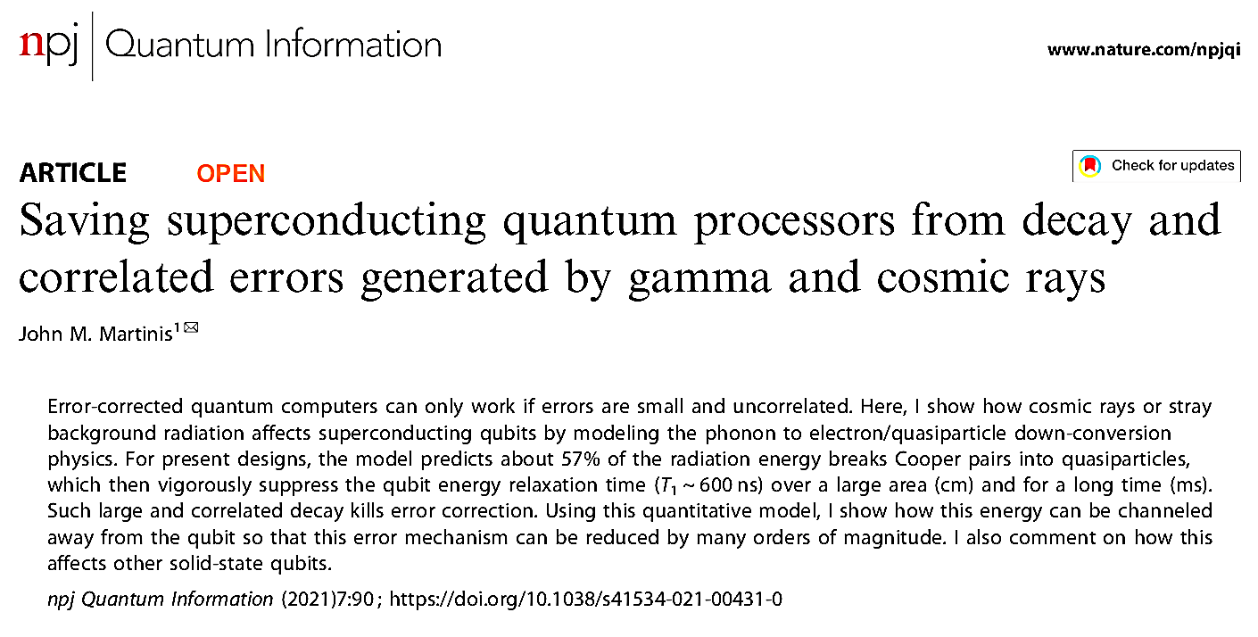
Quantum technologies and radiation physics
Quantum technologies, including quantum computing, have an intimate relationship with ion beam technology and radiation physics
Studies reveal that quantum computer errors can be correlated with cosmic rays
It is important to understand how the errors occurs and finding ways to mitigate them

Slide 4
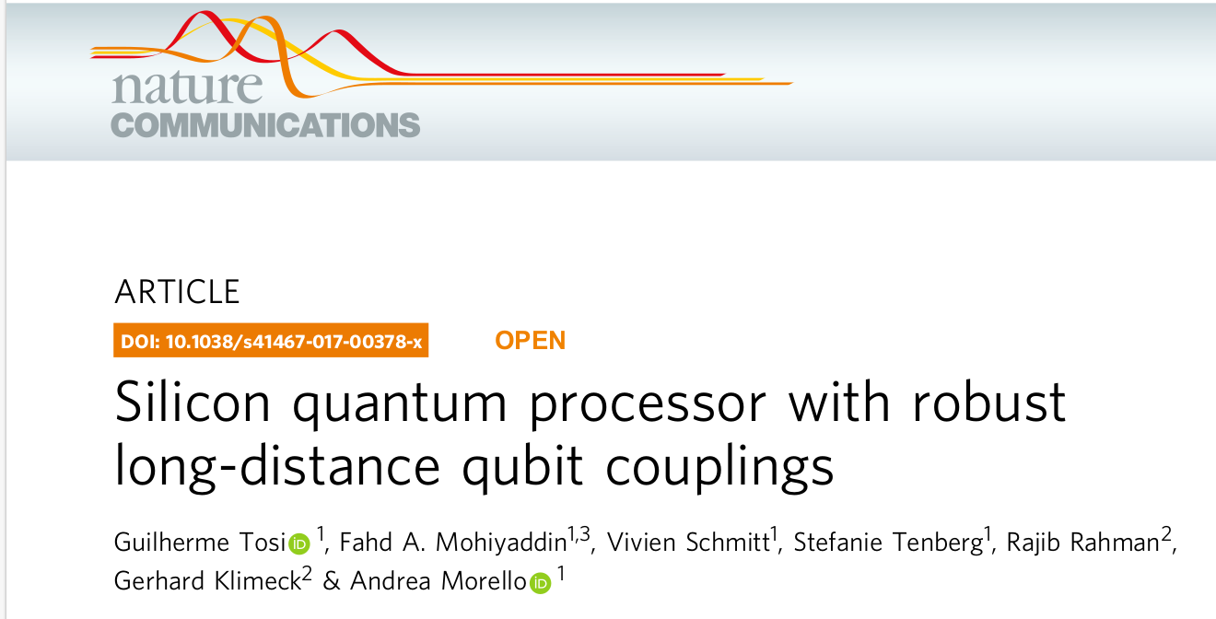
Solid state quantum computers: a challenge for ion beam technologies
A way to produce q-bits by single ion implantation (or deterministic implantation)
³¹P implanted into c-²⁸Si
Production of pure c-²⁸Si is a challenge
Deterministic implantation.
Spatial control (Berkeley) → Nano-aperture for final ion direction (via AFM)
Single ion control (Surrey)→ Optimized ion implanter and single ion detection
Resolution limited by angular straggling
Instrumental and theoretical research opportunities

Slide 5
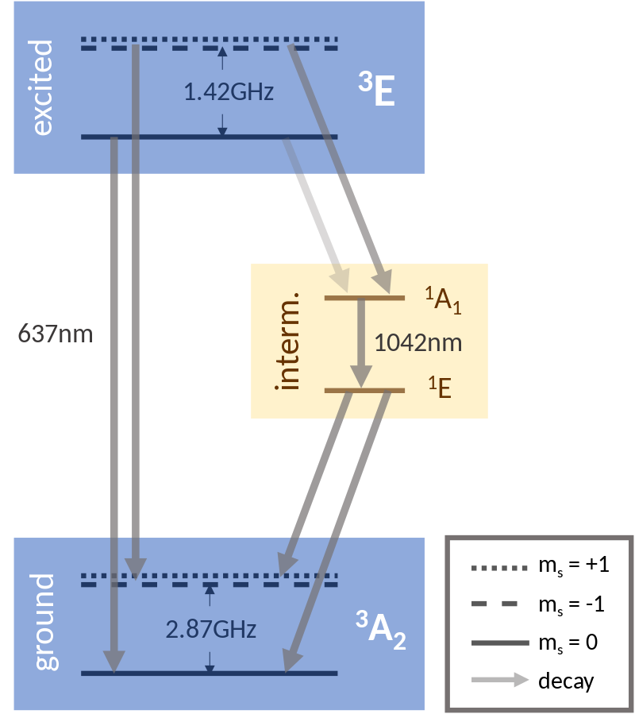
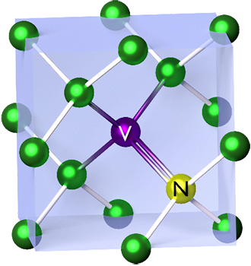
Quantum sensors and ion implantation
Nitrogen vacancy (NV) color centers in diamonds
NV centers emit bright red light (³E→³A transitions), if excited off-resonance by visible green light (³A →³E transitions)
Applications:
Quantum sensing: Extremely sensitive magnetic and electric field sensor
Quantum communication: Solid-state single photon emitters

Slide 6
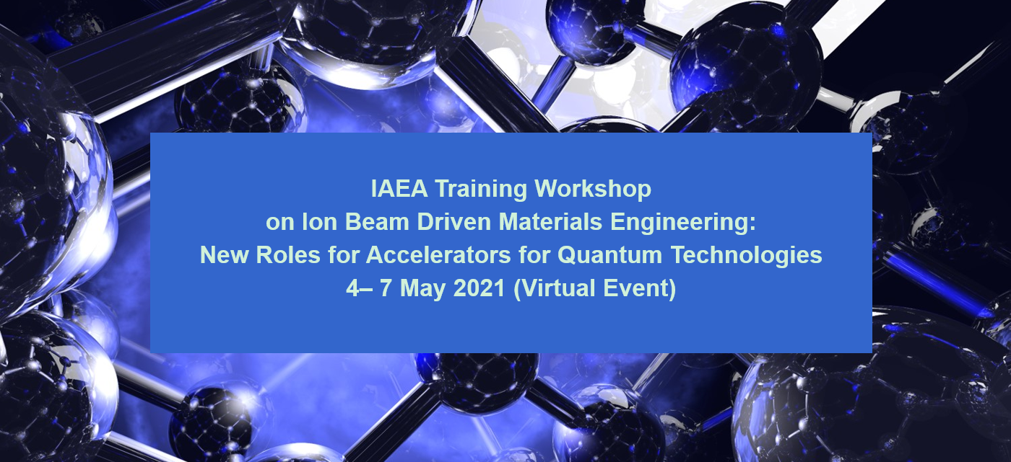
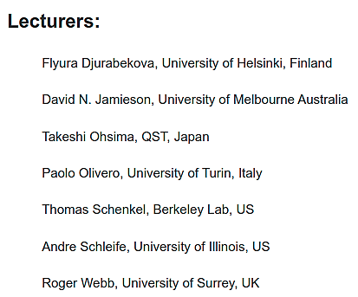
The IAEA training workshop
Event organized by leading groups and IAEA
Theoretical, experimental and instrumentation overview
Approximately 60 delegates from around the world
Key lecture topics:
First-principles techniques for materials modelling
Molecular dynamics simulations of cascades and swift heavy ions
Fundamentals-Ion matter interactions and Instrumentation
Present state of the art; deterministic doping, towards billion qubit machines
Simple: a single ion implanter, statistics of detection, etc.
Ion implantation to produce Isotopically pure layers:
Quantum gadgets and applications, quantum computing, quantum computer architectures
Single photon sources: quantum communication for a safe global network
Quantum sensing based on colour centres in wide bandgap semiconductors, brain sensing
Virtual laboratory visit of the Ion Beam Centre of university of Surrey, UK

Slide 7
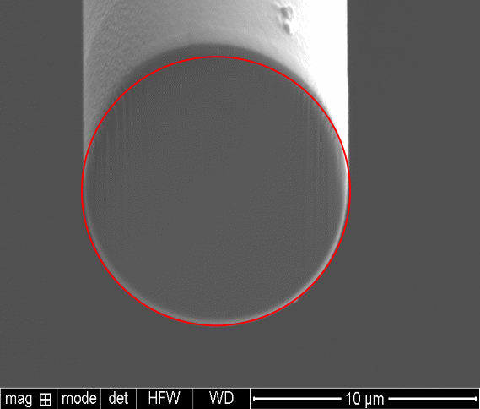
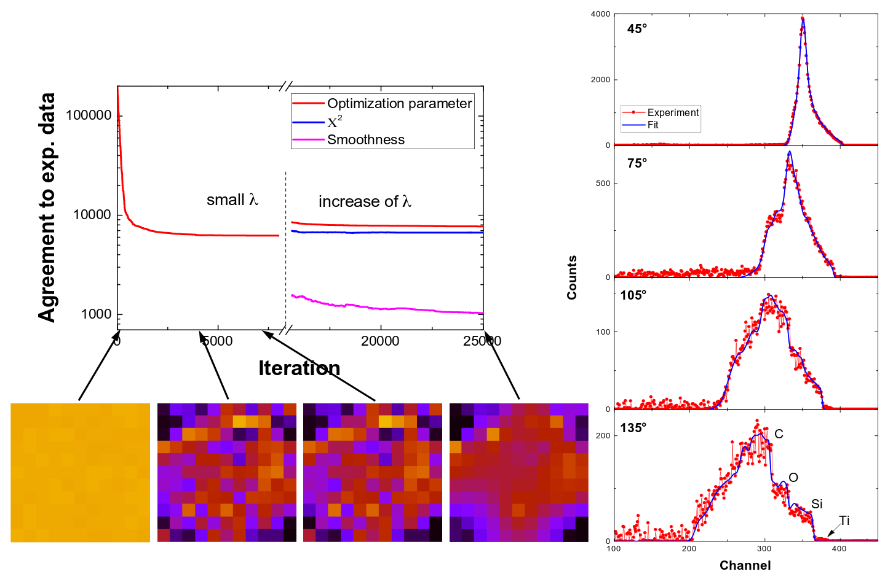
Nanotechnology and ion beams
Ion beam technologies are widely adopted in nanoscience, sintering and analysis
Surface patterning (spontaneous or not)
Elemental analysis
Dopping
However, Ion Beam Analysis is still underused
RBS tomography is presently under development in collaboration with the Max-Planck-Institut für Plasmaphysik
Tyranno fiber (SiC), UBE Industries
Circular cross-section
Deviation from circular < 5%
Diameter 11.7 ± 0.3 µm

Slide 8
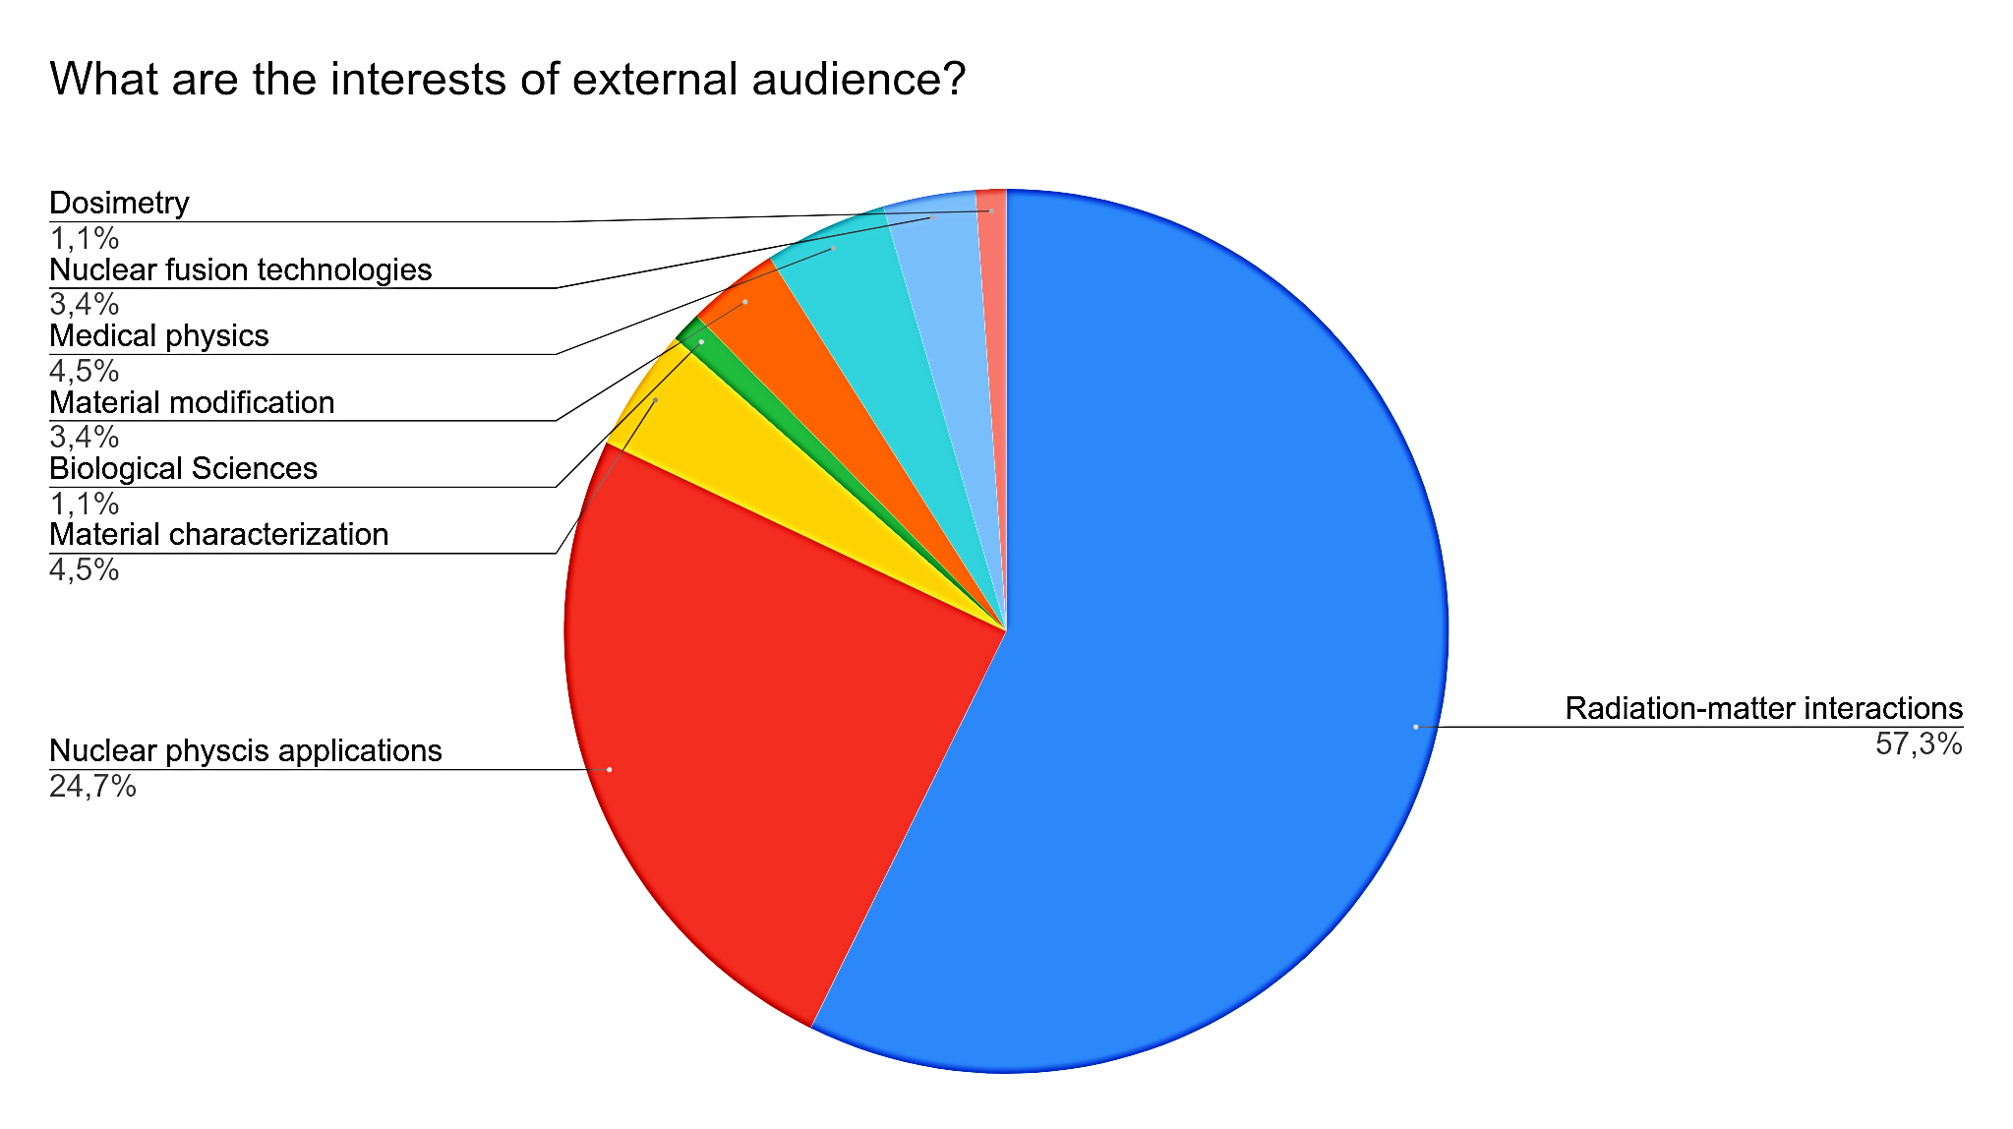
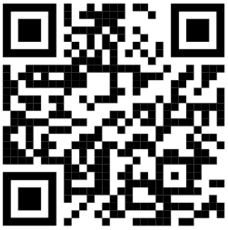
GFAA talks on applied physics with particle accelerators (2020-2022)
The interest in applications of ion beam technologies in Brazil is high
The talks promoted by the IFUSP research group express this in numbers
15 online events (3 foreign speakers)
More than 140 external participants
110 simultaneous participants in one event (medical physics)
Presentations publicly available on YouTube
Almost 100 views
Complete list of seminars in:
https://bit.ly/LAMFI-Seminars

Slide 9
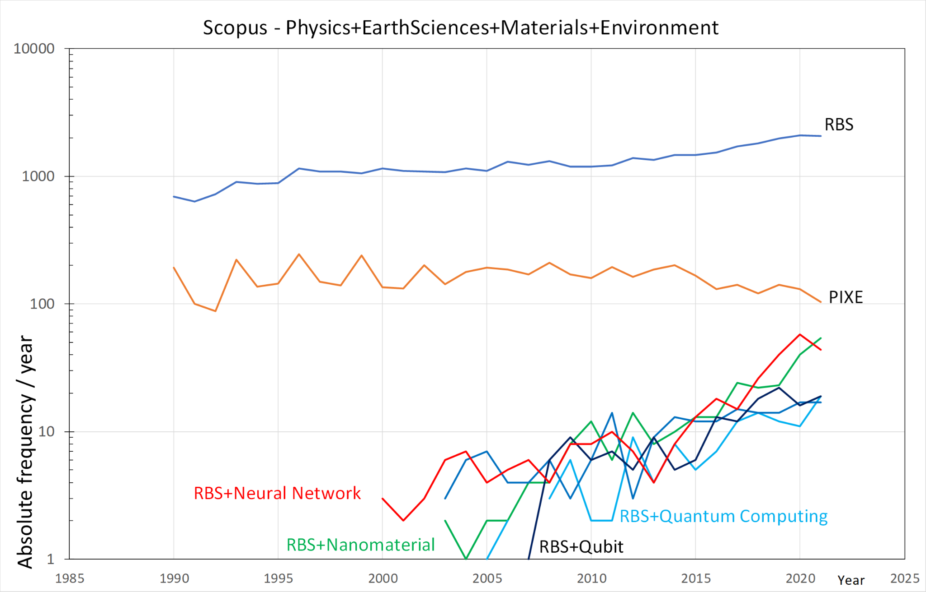
Trends (keyword search in the Scopus database)
almost stable
exponential growth

Slide 10
Summary
Relevance
Viability
Rationale
Human resources

Slide 11
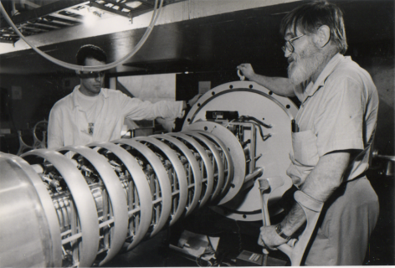
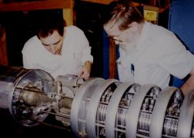
The LAMFI-USP ion beam analysis facility
Founded in 1992
Aiming at providing analysis to atmospheric studies and to support research on microelectronics at USP
First coordinator: Prof. Dr. Juan Carlos Acquadro
Second coordinator: Prof. Dr. Manfredo Harri Tabacniks
Current coordinator: Prof. Dr. Tiago Fiorini da Silva
Today, LAMFI-USP offers ion beam analysis or ion beam irradiations
Continuous improvements of available ion beam techniques

Slide 12
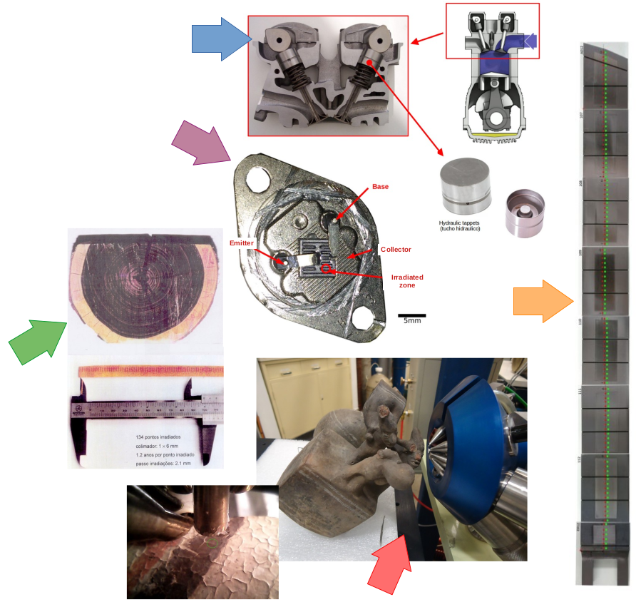
The LAMFI-USP
For material characterization and basic science
Thin films and coatings :
Magnetic films, diamond-like carbon, etc.
Radiation detectors and electronics :
Testing radiation hardness (TID) of detection systems, electronics and materials
Fusion materials :
Fundamental data, analysis of internal walls of W7x fusion reactor
Cultural heritage :
Authorship, origin, indirect dating
Environment :
Dendrochronology, spread of microplastics and the impact of technology residues
Fundamental physics :
Cross-sections and stopping power measurements

Slide 13
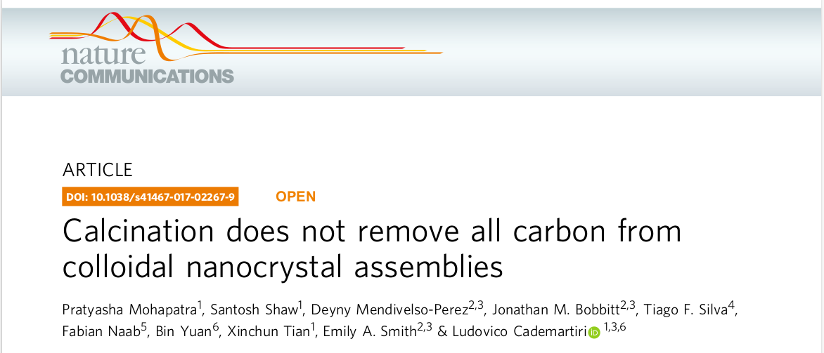
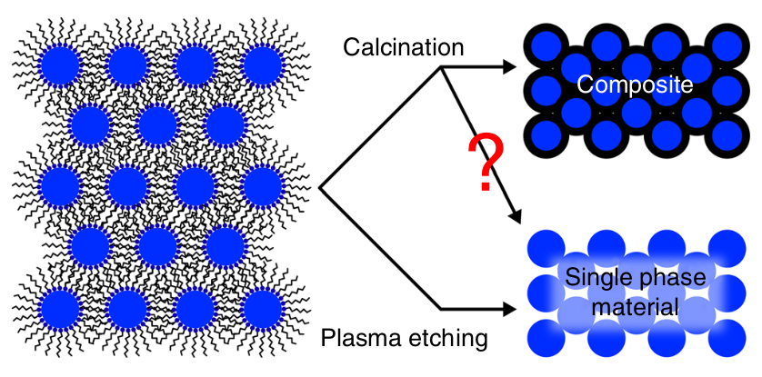
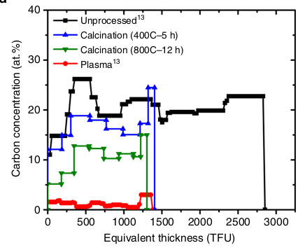
Nanotechnology and ion beams
Promoting scientific collaborations in nanoscience applications using Ion Beam Analysis
Multi-elemental characterization
Enabled by the MultiSIMNRA
Limited by depth-resolution
Monitoring of several elements (H, O, C, P, Si and Zr)
A multi-technique approach processed self-consistently
Results indicate C residues after calcination

Slide 14
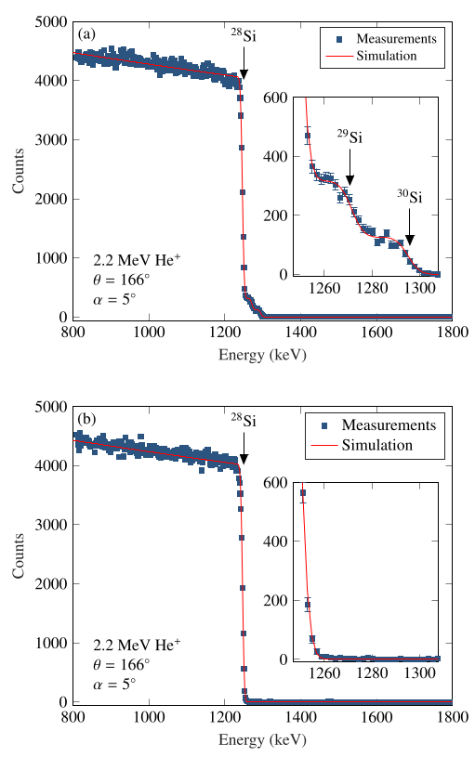
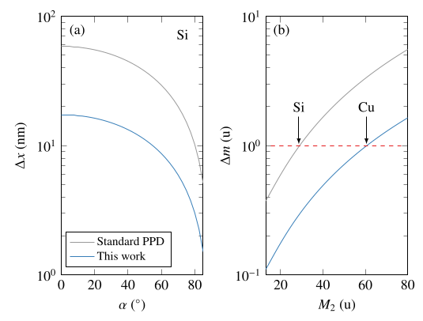
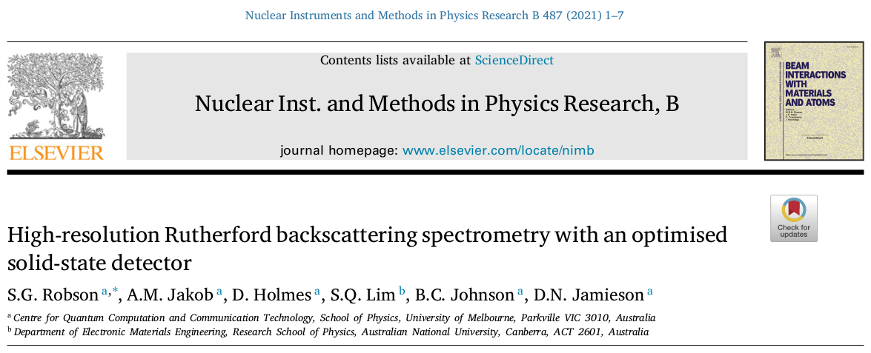
High resolution RBS with solid-state detectors
Improvements on electronics for nanometer resolution depth profiling
Artificial intelligence for laterally inhomogeneous samples (nanoparticles and nanostructures)
depth resolution
mass discrimination
E=2.2 MeV
ΔE=7.4 keV

Slide 15
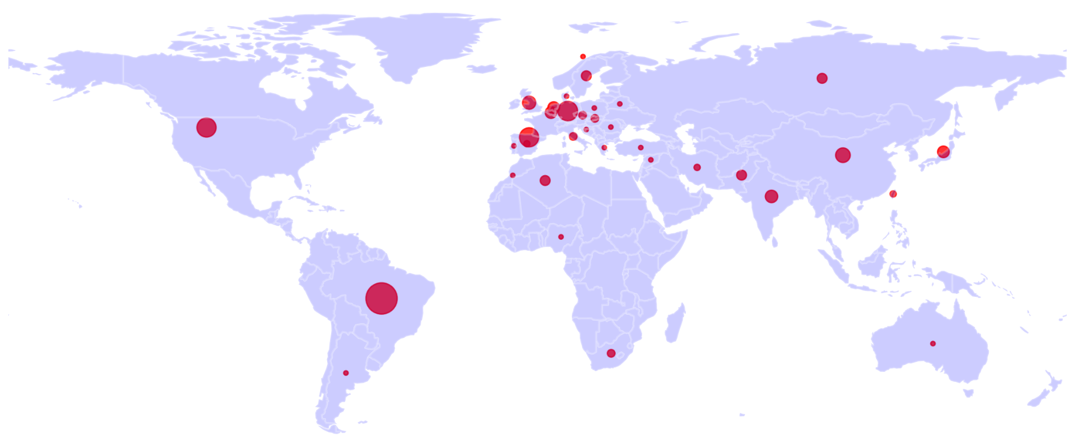
Worldwide leadership in data analysis and processing (Distributing MultiSIMNRA)
MultiSIMNRA enables self-consistent analysis of multiple techniques
Combines scattering techniques (RBS, EBS, ERD and NRA) in a unique model
Robust and free of bias objective function for multi-objective optimization
Standard protocol for evaluation of uncertainties
Integration with different material characterization techniques
MultiSIMNRA users around the world:
200 registered users from 35 countries worldwide

Slide 16
The AI4IBA collaboration network
An international collaboration network to develop and promote the use of artificial intelligence in IBA
Coordinated by the São Paulo group
Supervised methods for spectra processing and unsupervised methods for spectra classification
Scientific collaboration with interchange of students and researchers
Participants:

Slide 17
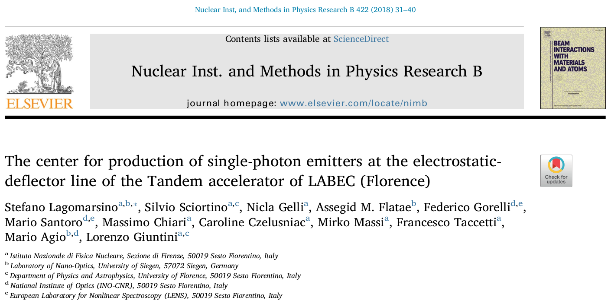
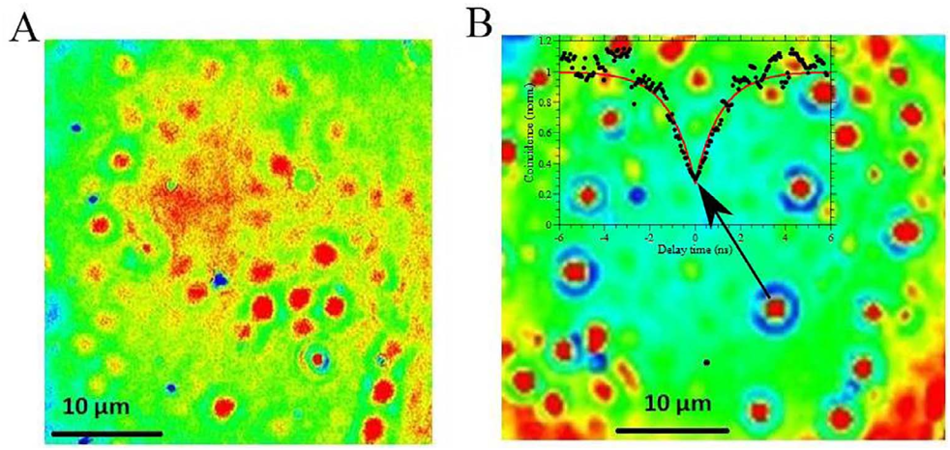
Producing quantum materials with electrostatic accelerators
Vacancy color centers in diamond produced by ~MeV ion implantation
Si implantation into diamond (Si-V)
10⁹ at./cm²
10⁸ at./cm²
Wide-ﬁeld ﬂuorescence image of SiV color centers

Slide 18
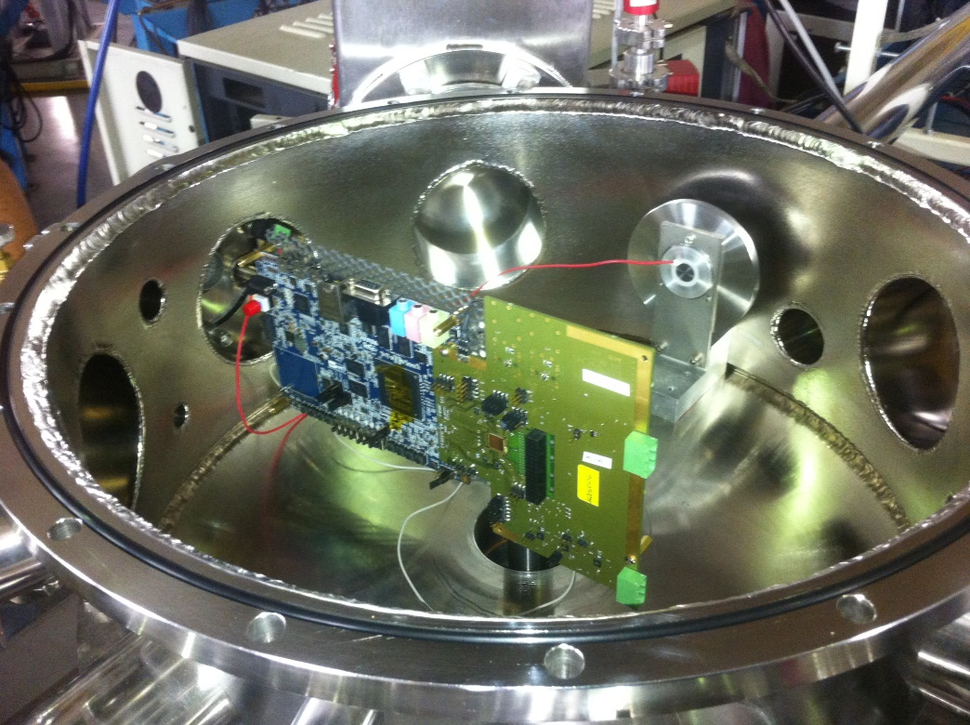
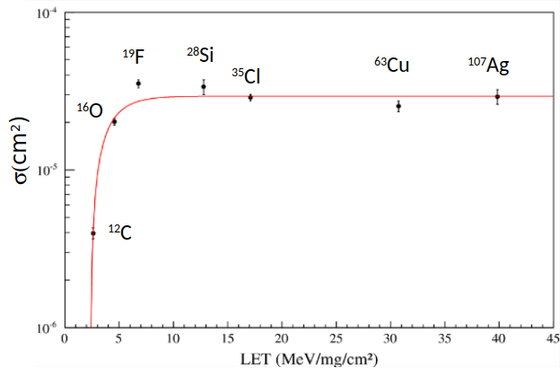
The LAFN facility for very low intensity beams
Flux 100 to 100,000 part/cm²s
Fluence 106 to 107 part/cm²
< 10% uniformity variation
up to 30 mm depth
Ion Beam Induced Charge (IBIC) is a key technique for studying quantum materials
Fully operational at the IFUSP 8MV tandem accelerator
Currently used for SEE testing of electronic devices
MOSFET transistor (3N163)
σ_{sat} = 294(10)10⁻⁵ cm²
LET_{th} = 2.35(36) MeV/mg/cm²
W= 1.06(11) MeV/mg/cm²
S = 0.62(10)

Slide 19
Summary
Relevance
Viability
Rationale
Human resources

Slide 20
Rationale
O IFUSP, através do Laboratório de Análises de Materiais com Feixes Iônicos (LAMFI), vem mantendo posição de liderança mundial na área de Análise de Materiais com Feixes Iônicos. Todavia, para inovar na fronteira do conhecimento em aplicações emergentes usando feixes iônicos, um novo pesquisador é necessário.
A busca por palavras chave na literatura internacional (Scopus) mostrou que tópicos como “RBS” ou “PIXE”, os métodos analíticos tradicionais, apresentam uma tendência relativamente estável, com “RBS” comparecendo em 1000 a 2000 publicações por ano. A mesma busca, quando cruzada com palavras chave “quantum computing”, “nanomaterial” ou “Neural Network” produz muito menos referências, entre 10 a 70 por ano, todavia com crescimento exponencial. Essa é a área de pesquisas que desejamos atacar.
O novo pesquisador, deverá desenvolver o uso de feixes iônicos em Nanotecnologia, Inteligência Artificial, Computação Quântica e colaborar com o desenvolvimento de instrumentação ou materiais conformes. Várias abordagens experimentais existem ou são potencialmente promissoras: tais como micro feixes, MEV-SIMS, Maldi, Luminescência induzida com feixes iônicos e outros.
O candidato deverá propor a extensão e desenvolvimento do arranjo experimental atual, explorando novas fronteiras e aplicações de feixes iônicos, assim como potenciais aplicações.

Slide 21
Scientific team
Prof. Dr. Manfredo Harri Tabacniks
Ion beam analysis,
Prof. Dr. Nemitala Added
Ion beam analysis,
Prof. Dr. Márcia Almeida Rizzutto
Cultural heritage
Prof. Dr. Tiago Fiorini da Silva
Nuclear instrumentation, radiation detectors, data analysis, computational modeling.
Prof. Dr. Nilberto Medina
Radiation hardness of electronic devices

Slide 22
Summary
Relevance
Viability
Rationale
Human resources

Slide 23
Human resources
Centers for ion beam technologies with research programs in material sciences:
In Brazil:
IFUSP, UFRGS, UFRJ, UFF, PUC-RJ (at least 9 postdocs with potential interest)
In the world:
Université de Saclay, Jülich Forschungszentrum, Max-Planck Institut, Université de Namur, NPL
Pioneers in ion beam technologies for quantum materials:
California Berkeley University, University of Surrey, INFN, University of Melbourne

