Slide 1

Informática de Materiais: modelagem e/ou experimental
Proponente: Grupo Teórico do Departamento de Física dos Materiais e Mecânica
Antônio José Roque da Silva
Caetano Rodrigues Miranda
Gabriel Teixeira Landi
Helena Maria Petrilli
Lucy Vitória Credidio Assali
Luís Gregório Dias da Silva
Marília Junqueira Caldas
Instituto de Física da USP
crmiranda@usp.br

Slide 2
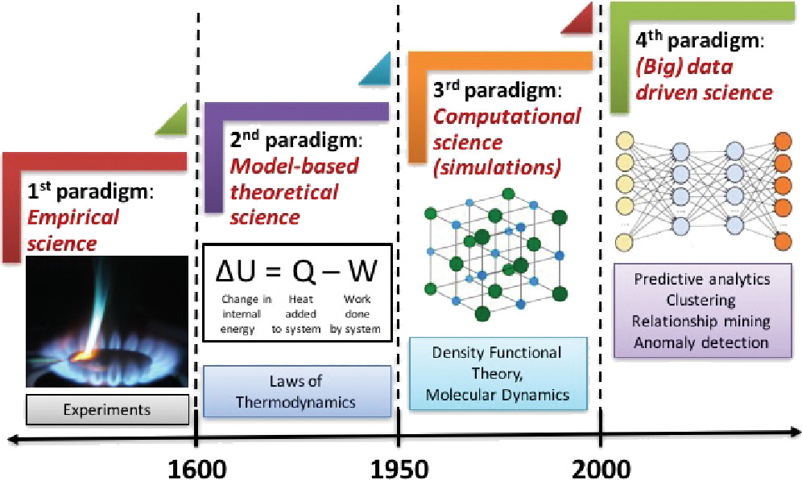
Paradigmas na física dos materiais
FIG. 1. The four paradigms of science: empirical, theoretical, computational, and data-driven.
Published in: Ankit Agrawal; Alok Choudhary; APL Materials 4, 053208 (2016)
DOI: 10.1063/1.4946894
Copyright © 2016 Author(s)

Slide 3
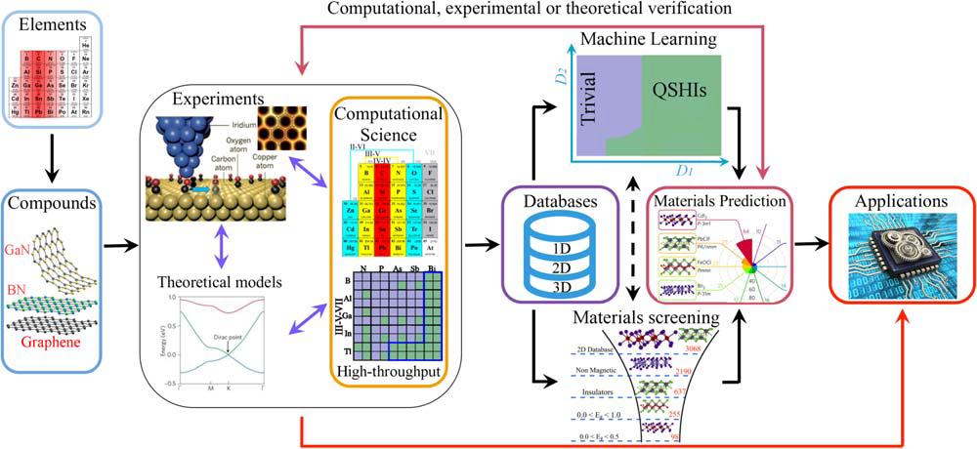
Informatica de materiais
Schleder et al., Journal of Physics: Materials 2 (3)

Slide 4
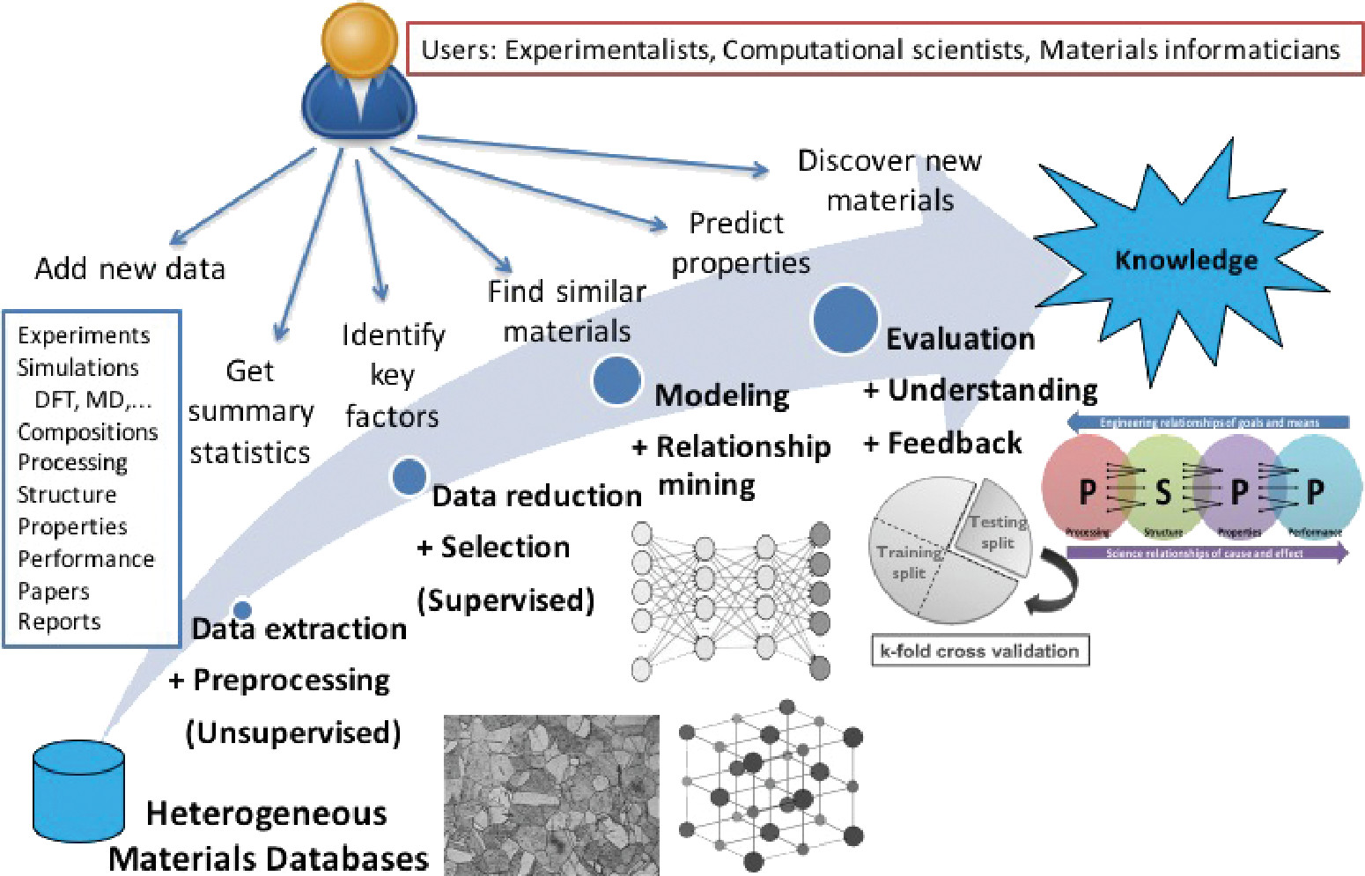
Descoberta de novos materiais
Published in: Ankit Agrawal; Alok Choudhary; APL Materials 4, 053208 (2016)
DOI: 10.1063/1.4946894

Slide 5
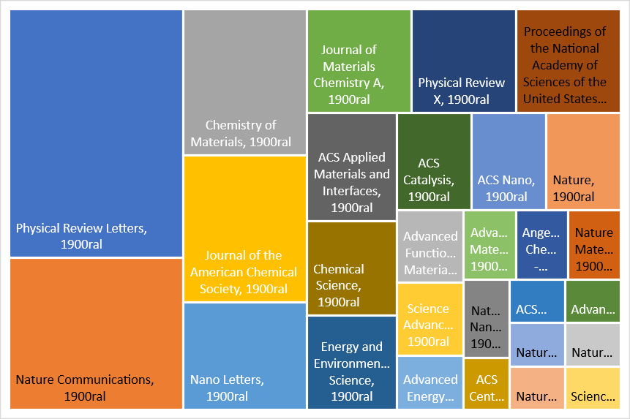
Publicações

Slide 6
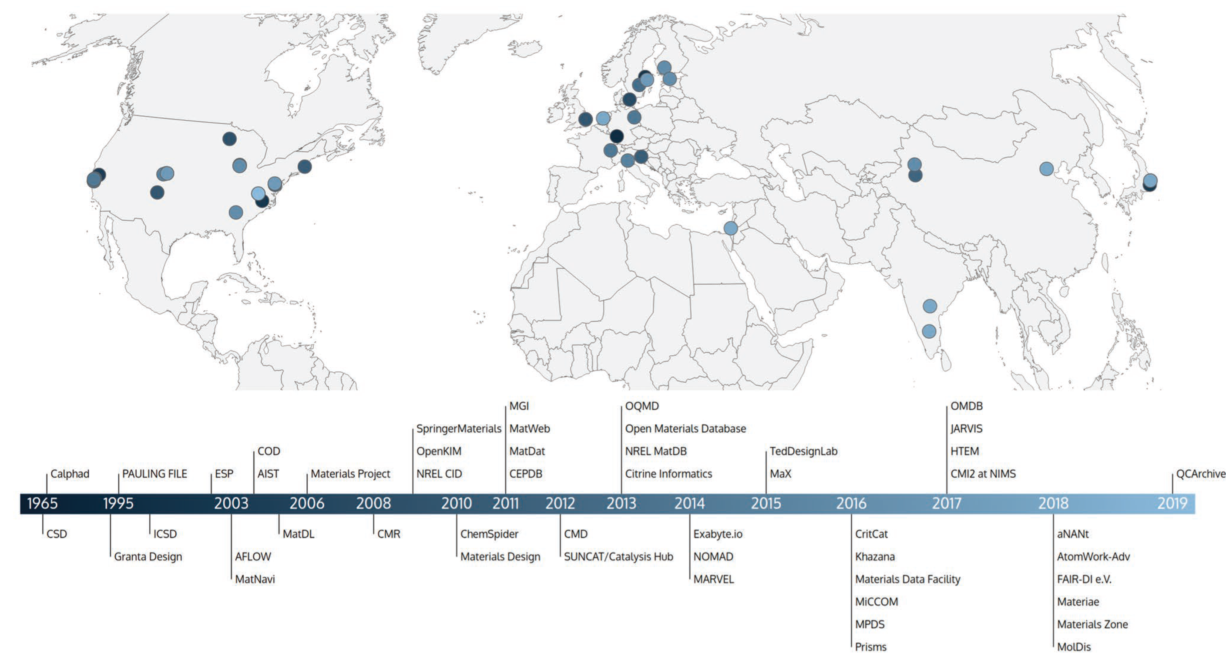



Iniciativas no mundo

Slide 7
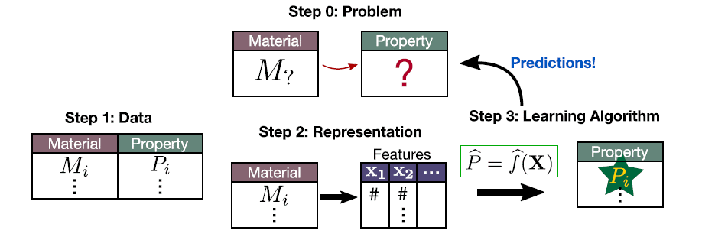
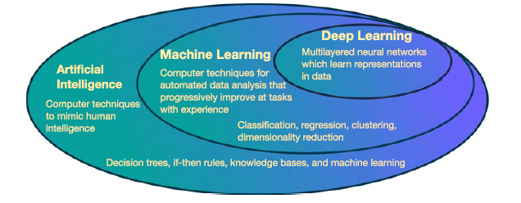
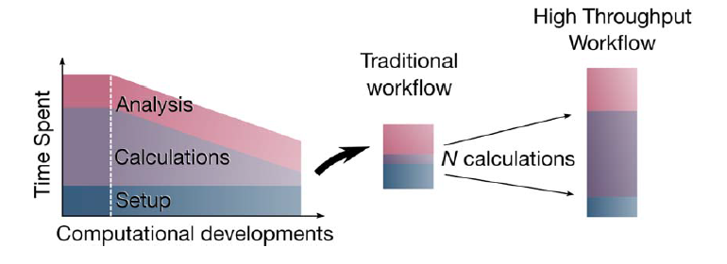
Previsões baseadas em aprendizado de máquina

Slide 8
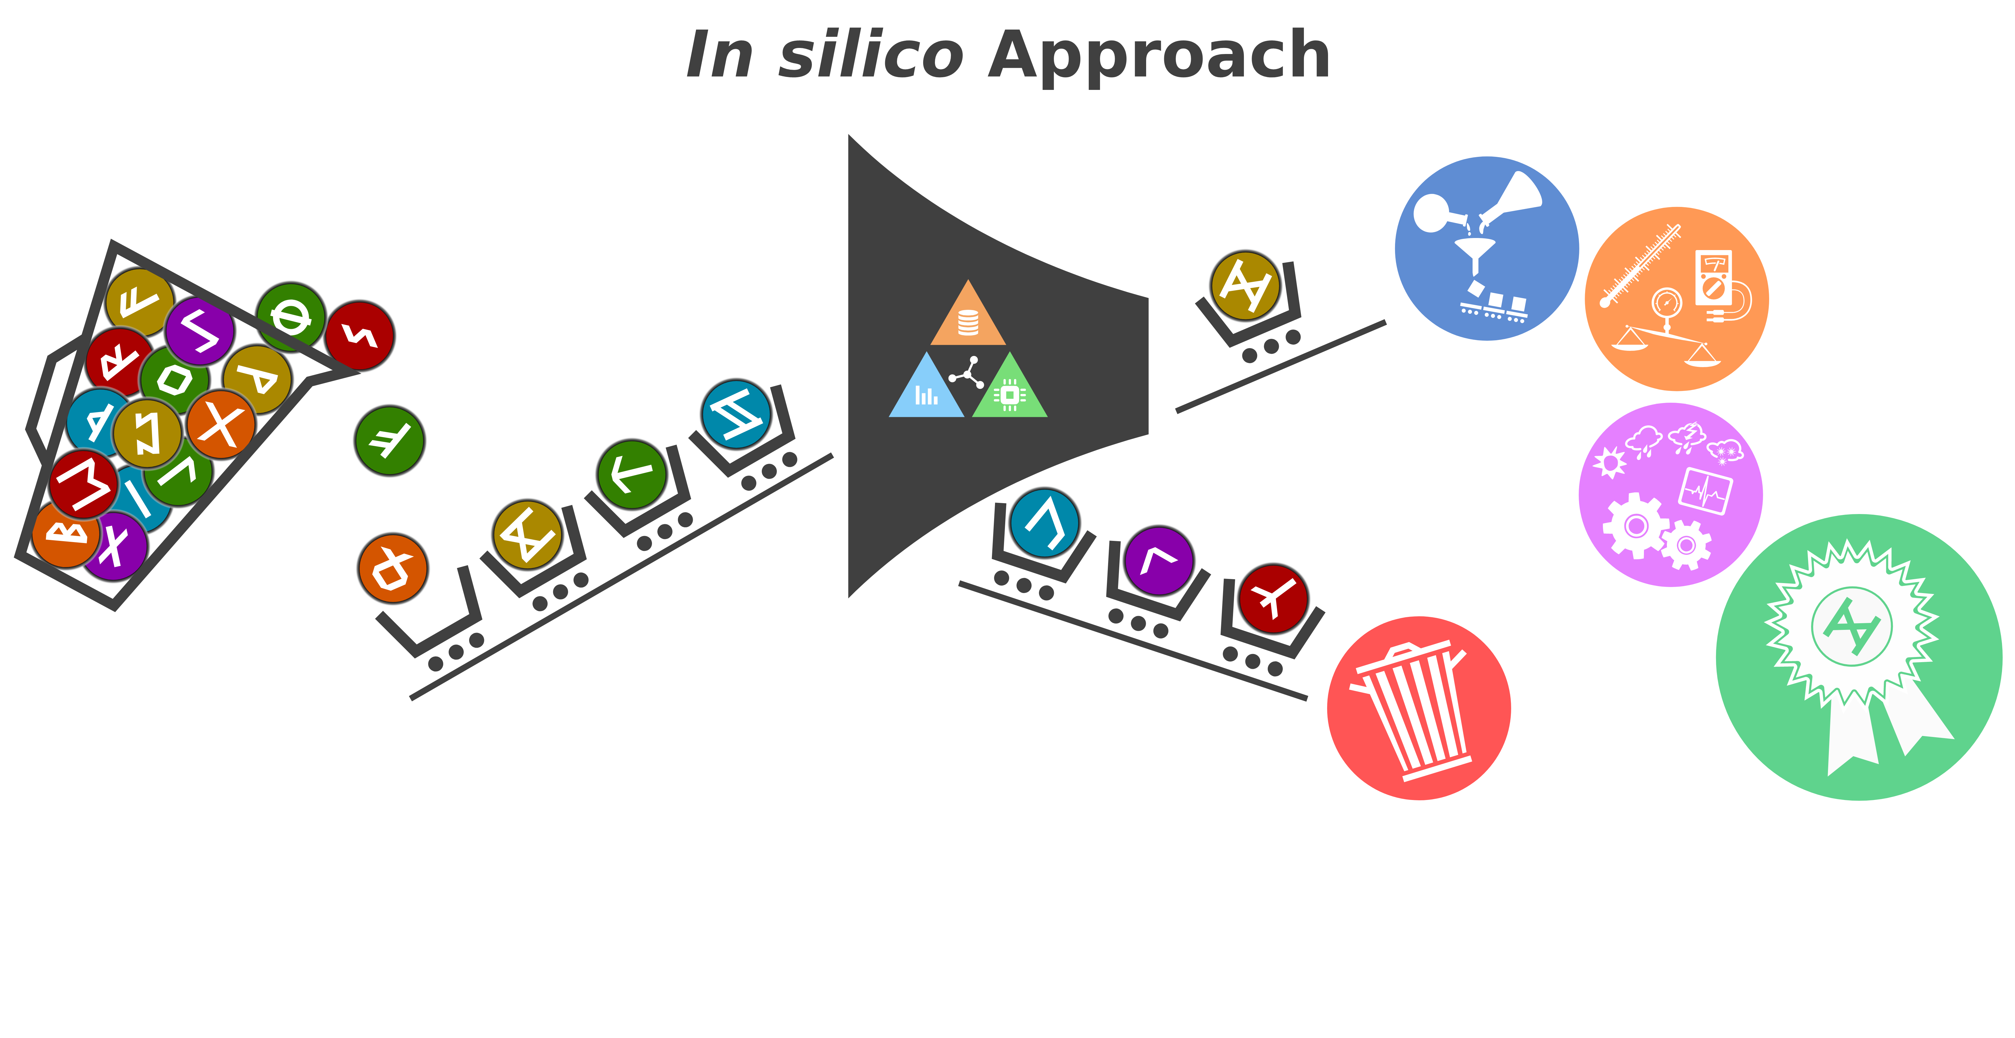
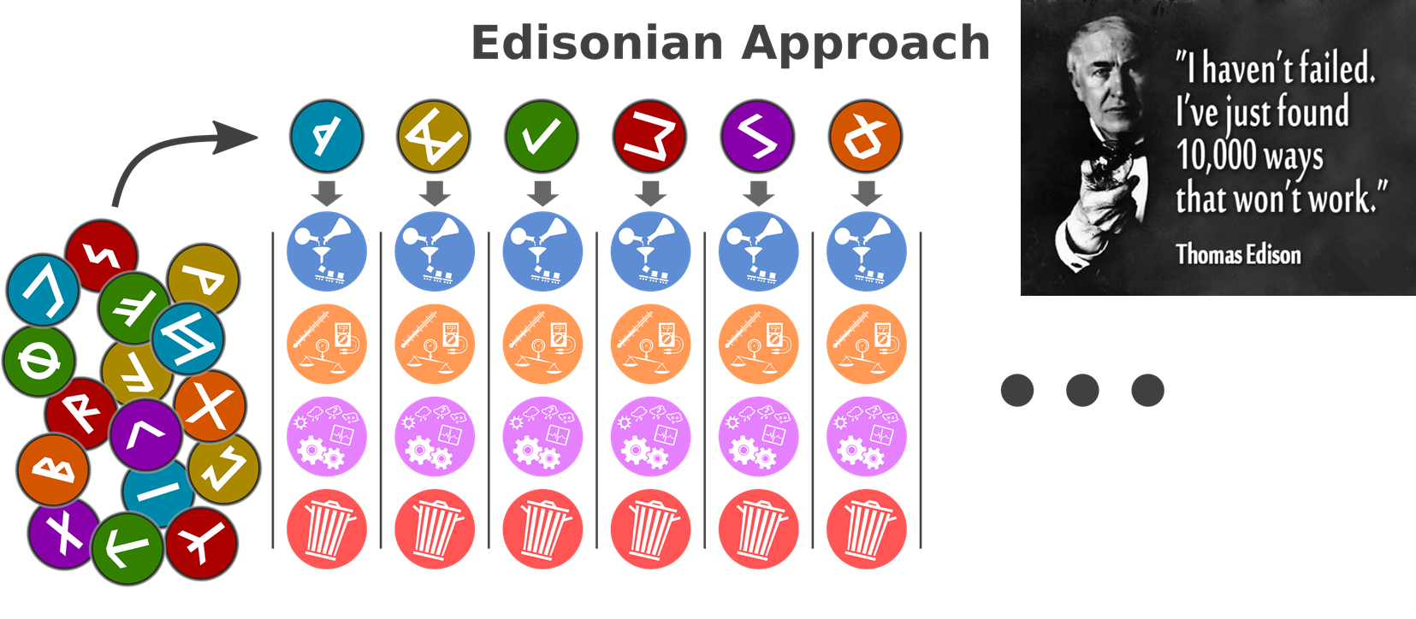
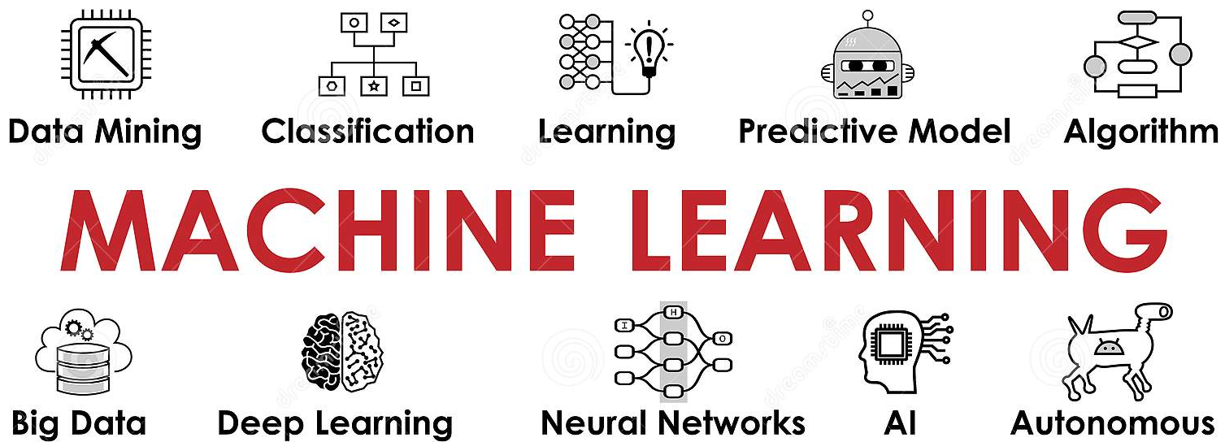



Industry 4.0 and enabling technologies
DATA ANALYTICS
Only the best candidates have to be synthesized,
characterized and tested, resulting in large cost and time savings
Each candidate has to be synthesized, characterized and tested
EXTENDED REALITY
Images from the web
DIGITAL TWIN

Slide 9
Exemplo – design de materiais para anodos

Slide 10
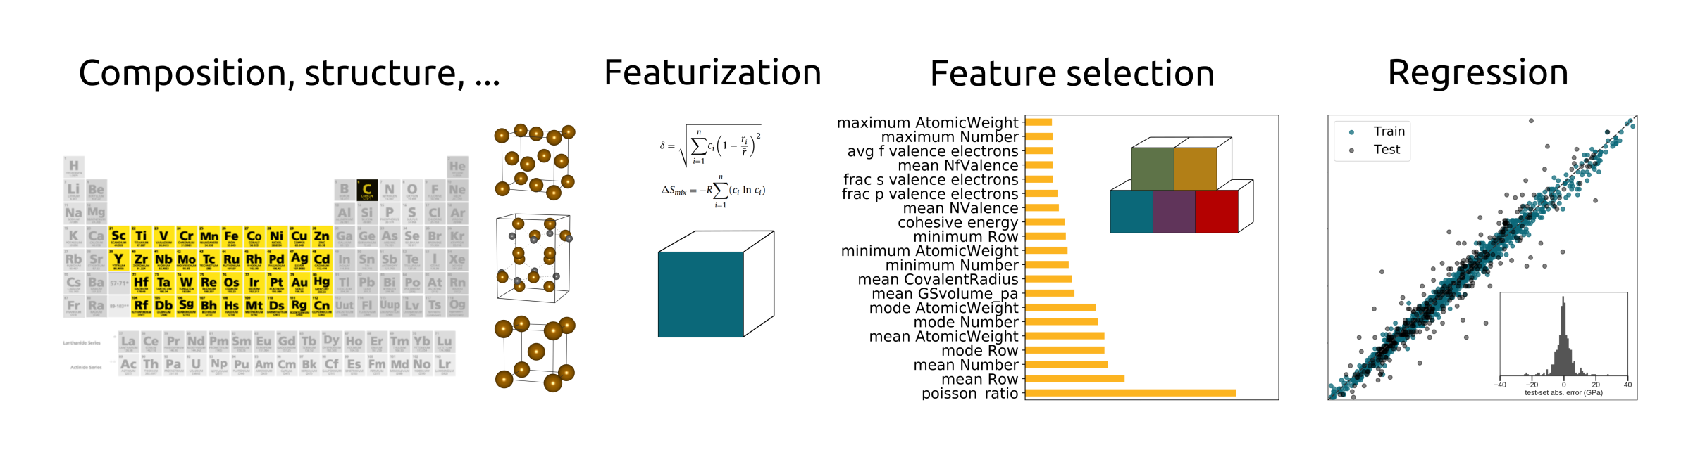
Strategy - elastic predictions based on the composition only
Databases > Compositional features > Machine learning > Predictions
Notes:
the idea of this work was to make elastic predictions based on the composition only.
the dataset was limited to compounds containing transition metals and post-transition metals only. (13,619 entries)
The idea behind this screening was to exclude compounds in which bonds have a predominant ionic or covalent character.
(4265) entries remained after the first filtering step.
the search space was restricted to fit the elastic property range in which Ti alloys are found (Only 2566 entries)
we sought composition- based descriptors suitably depicting the elastic properties.
we also exploited the Miedema and Yang solid solution (heat of formation of binary compounds and entropy of mixing)
In total, 158 descriptors were obtained which lead us to final 1826 instances
An important exploratory step in ML projects is to check which features are potentially the best
to describe a specific target property
the elasticity data of more than 1800 compounds from the Materials Project fed linear models, random forest regressors, and artificial neural networks (NN), with the aims of training predictive models for K and G based on compositional features.

Slide 11
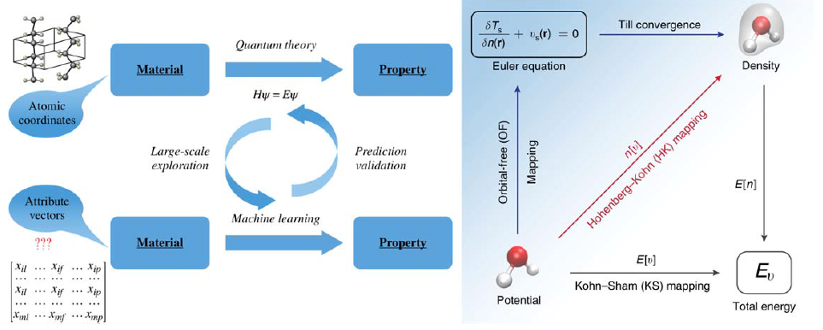
Previsões baseadas em aprendizado de máquina

Slide 12
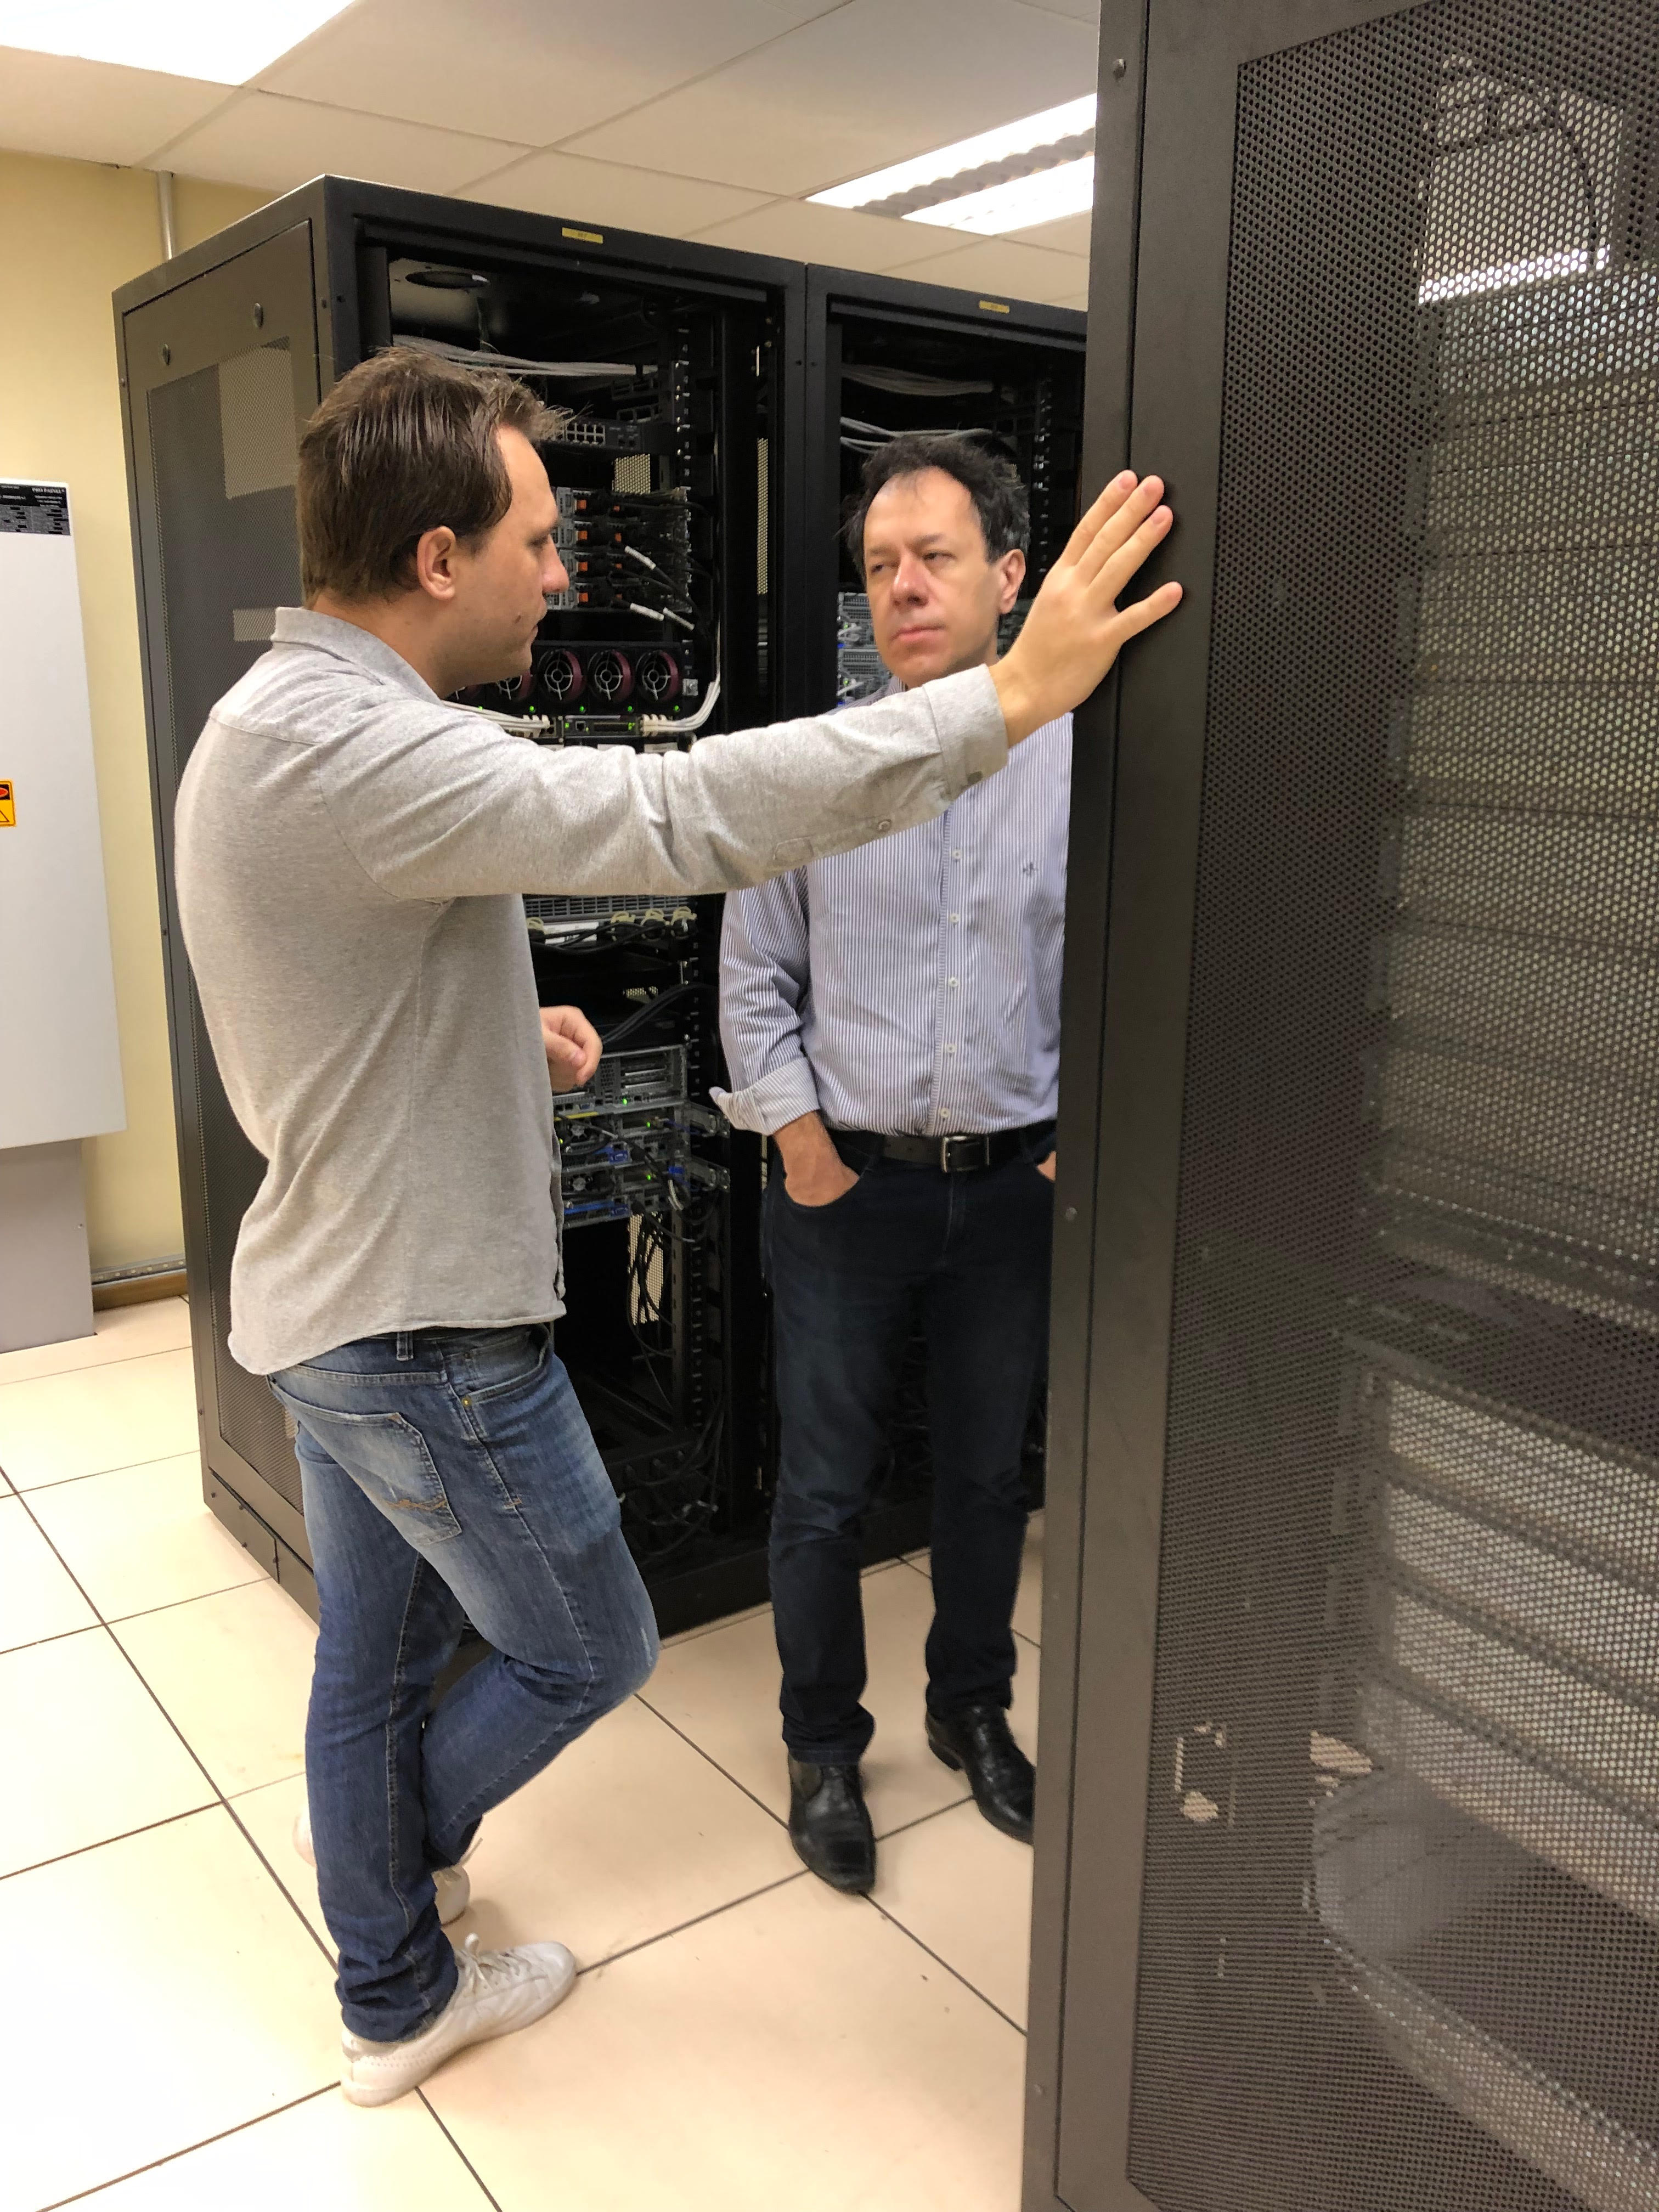
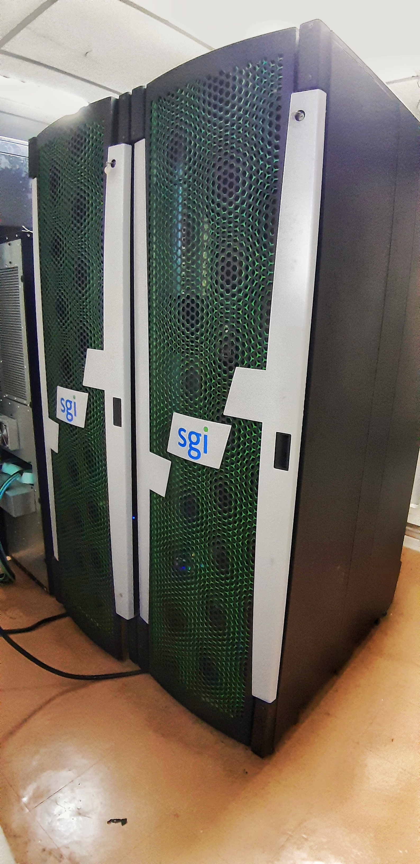
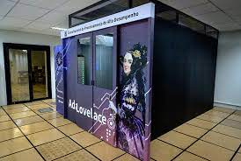
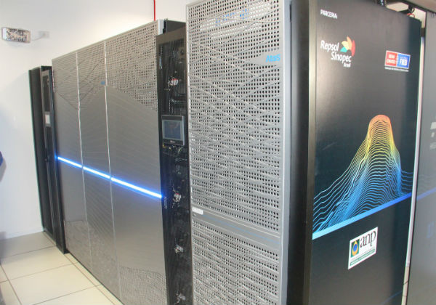
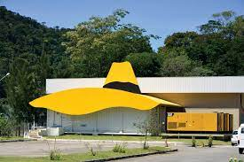
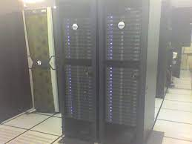
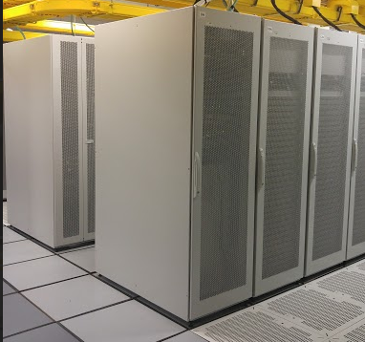
Viabilidade
CCIFUSP
AIRIS
CENAPAD - SP
USP - SGI
Santos Dumont - LNCC

Slide 13
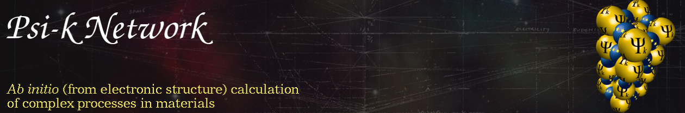
Prognóstico de potenciais candidatos
85% de novas posições em Informática dos Materiais
Prêmios de melhor tese (Capes / SBF )
Jovens lideranças em grupos renomados dentro da própria USP, Unicamp, UFABC, UFMG e UFRJ
Candidatos internacionais (Materials Project, NCCR Marvel, NOMAD, AFLOW, ...)

Slide 14
Oportunidades
Graduação – Reforço na Física Computacional
Projetos com o setor produtivo
Métodos de IA em Física
Liderança nacional na Física dos Materiais

Slide 15
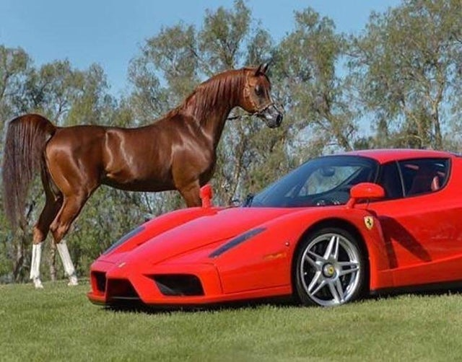
Sumário
Área: Informática de Materiais
Temas: Cálculos de Primeiros Principios, Modelagem Molecular, Triagem de alto desempenho de materiais, Inteligência Artifical e Aprendizado de máquina aplicadas a Física da Matéria Condensada.

